Slide 1
UnitedTune
Team 2:
Project Manager: John Brilhart
Product Owner: Jay Patel
Lead Business Analyst: Yashwanth Varre, Ge Ou
Lead Developer: Hetali Chavda-Former & Revati Deshmukh-Current
DBA: Revati Deshmukh
QA Analyst: Suraj Suwal
Tester: Soyeon Ju
GitHub Repository Slides & Source Code Sample

Slide 2
GitHub URL:
https://github.com/deshmukh06/CS-691-Project.git

Slide 3
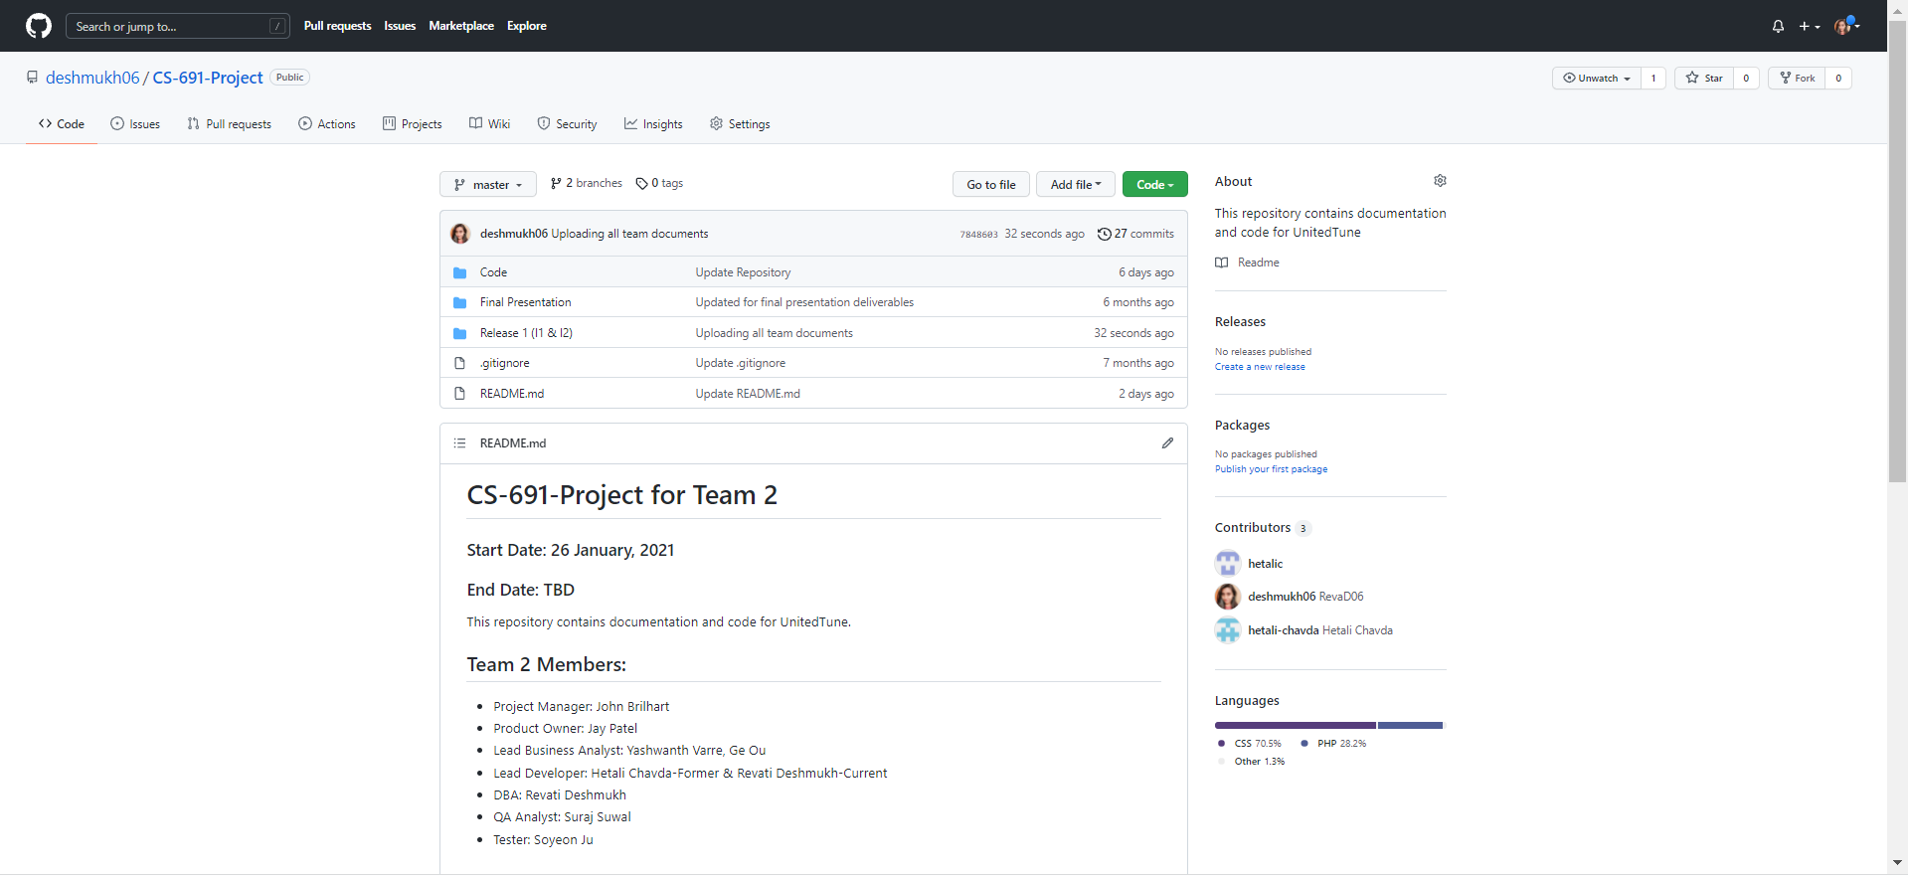
Repository Structure

Slide 4
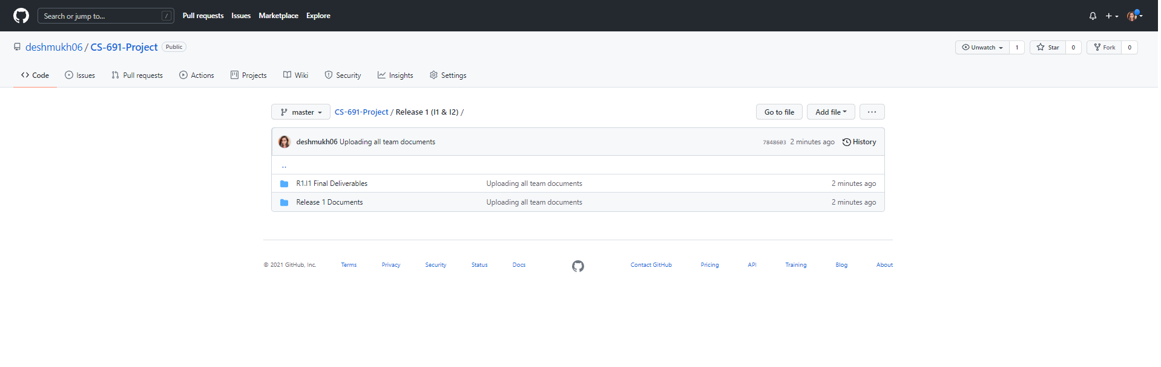
Repository Structure - To Manage Documents

Slide 5
Build & Deployment Procedures:
Prerequisites:
For Windows:
WAMP Server
For Linux:
LAMP Server
Composer
Git

Slide 6
Installation Steps:
Steps:
Download GitHub Repository in your local machine
Create folder “united_tune” into WAMP Servers www folder i.e. “wamp64 > www > ” and place the content of “Code” folder into “united_tune”
Import the database in PHPMyAdmin and change MySQL Database Credentials into united_tune > config > app_local.php if require.
Open browser and run: “http://localhost/united_tune/”

Slide 7
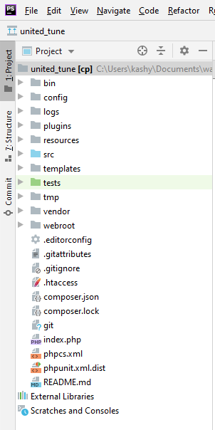
Source Code - Folder Structure

Slide 8
0.1 Customer Account
Features Implemented:
1.5 Update account
1.6 Delete account
1.7 View booking history

Slide 9
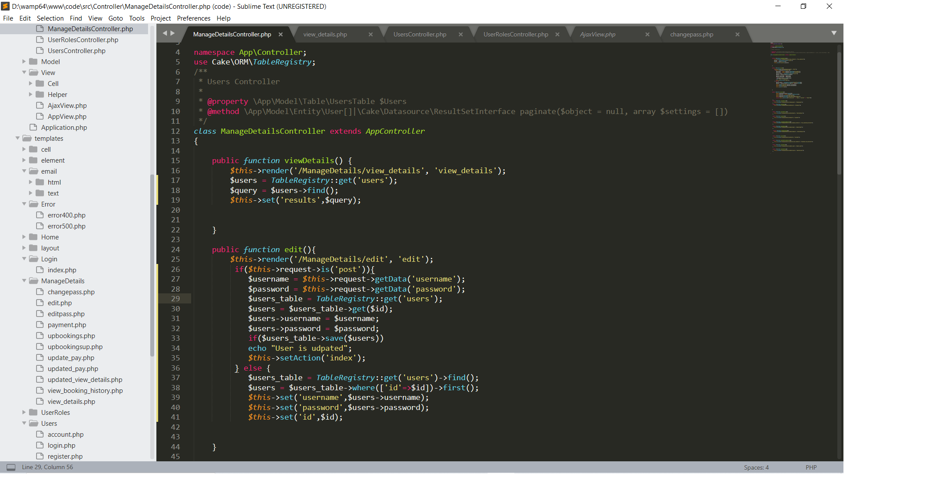
Source Code Sample: 1.5 Update account

Slide 10
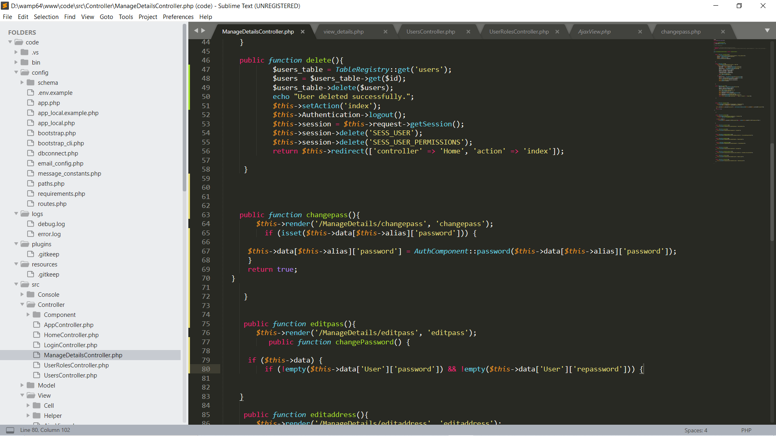
Source Code Sample: 1.6 Delete account

Slide 11
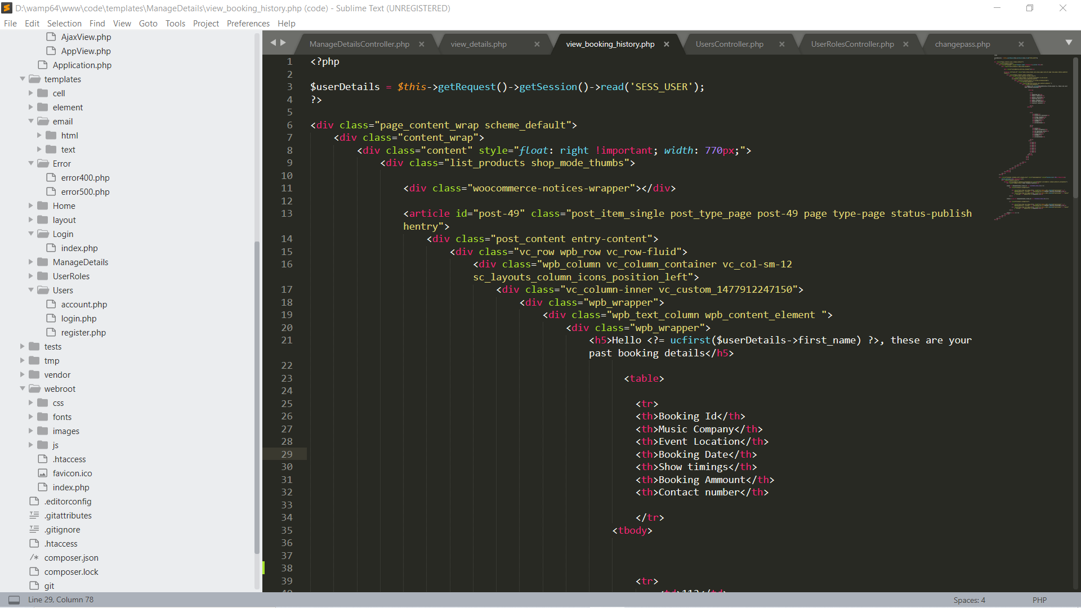
Source code sample : 1.7 View Booking History

Slide 12
0.2 Musician Account
Features Implemented:
02.03 View booking History
02.06 Update Account info
02.07 Close Account

Slide 13
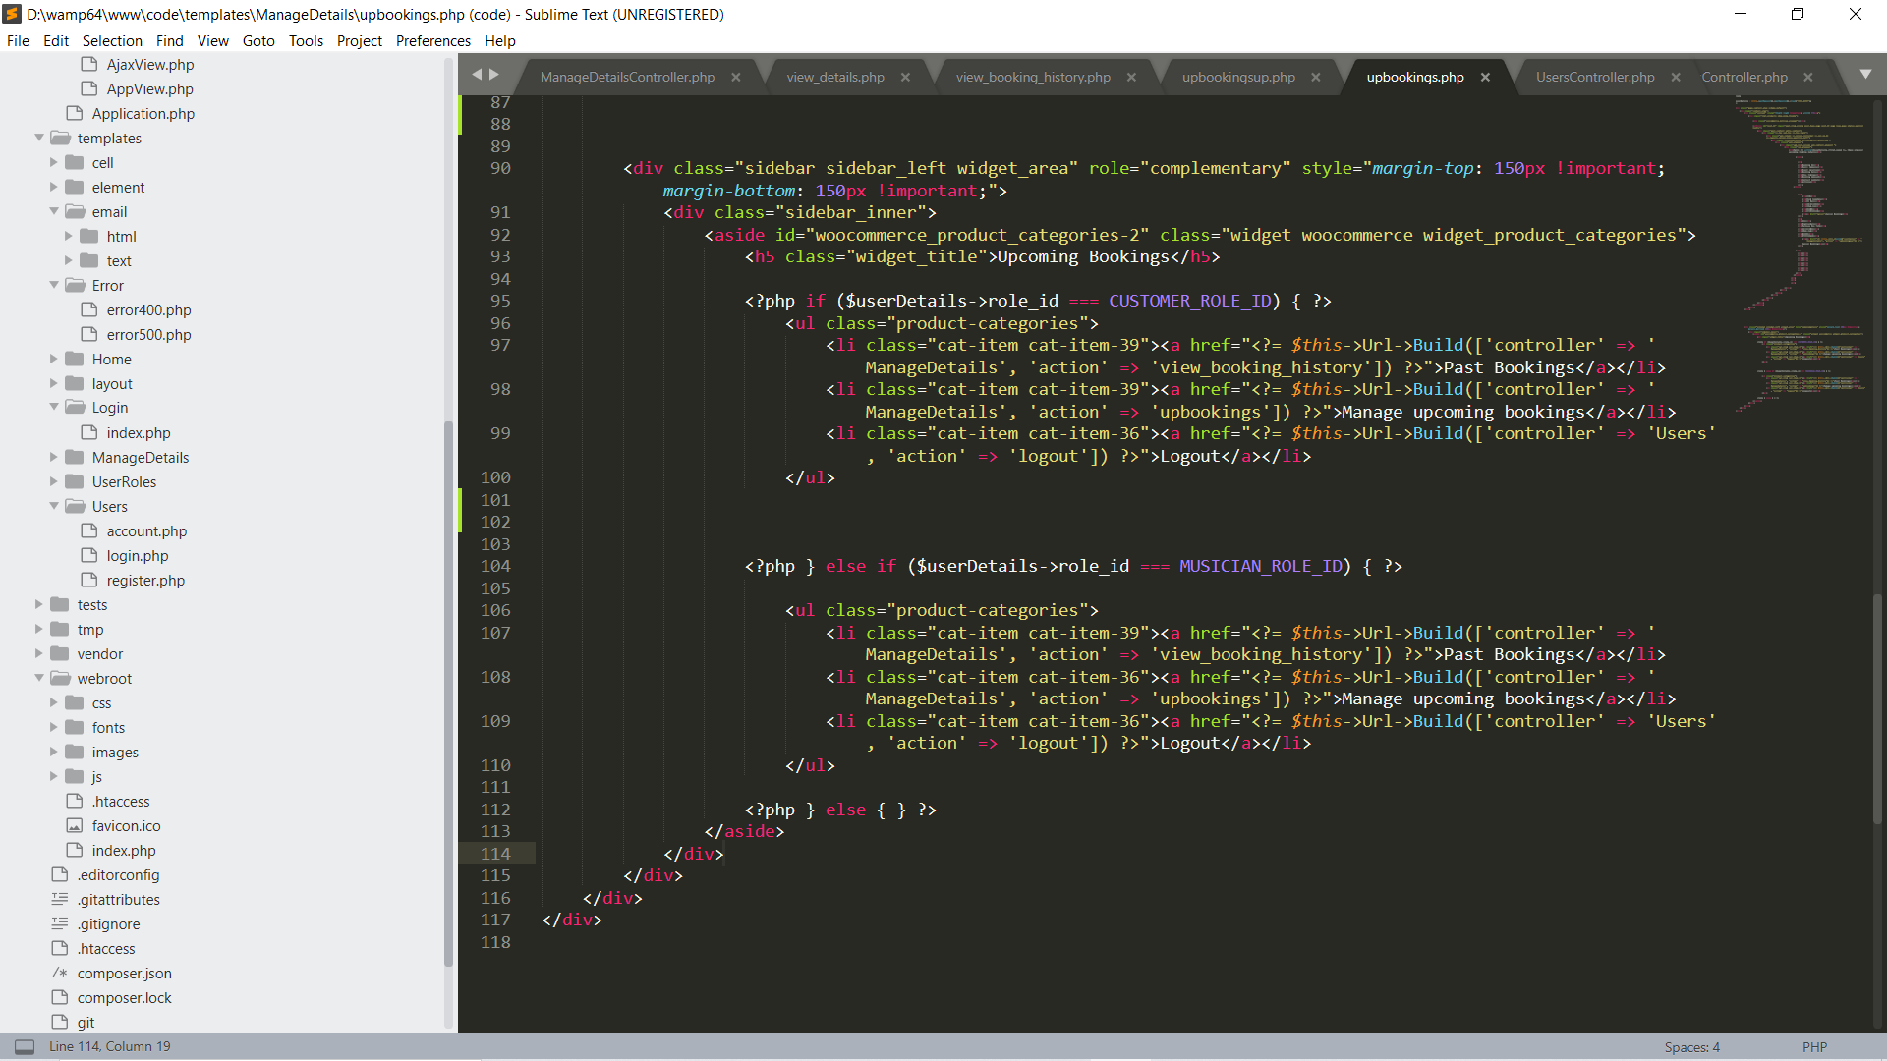
Source Code Sample: 02.03View booking history

Slide 14
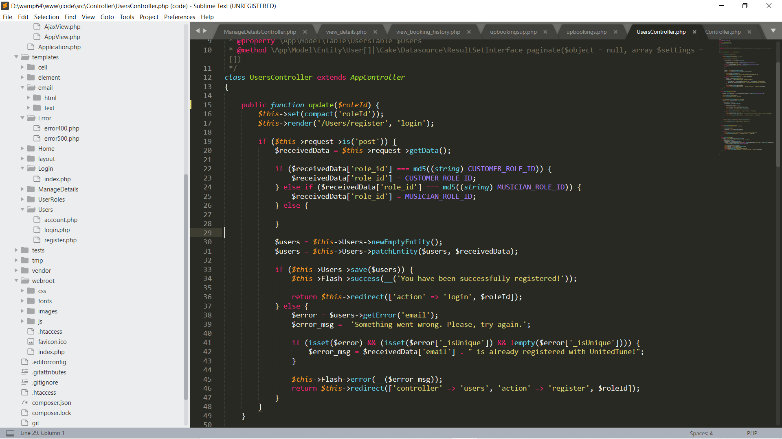
Source Code Sample: 02.06 Update account info

Slide 15
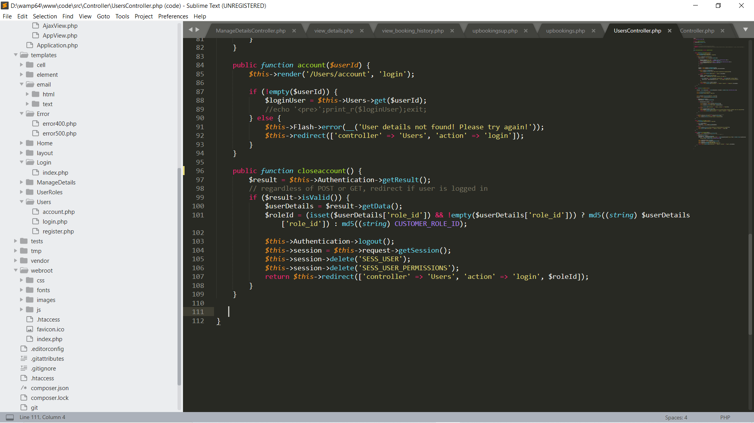
Source code sample : 02.07 Close account

Slide 16
Thank You

